Slide 1

FIRE WEATHER MONITORING PROJECT
ByteSmart Internship | Research, IoT Pipeline, Dashboard & ML Portfolio
From Jena climate research to a live MQTT, PostgreSQL, dashboard, and ML demonstration.
Notes:
[Sources]
- Weather Archive Jena dataset and research sources listed on slide 26.
- Fire_Weather_Monitoring_Deep_Dive.docx.

Slide 2
RESEARCH FRAMEWORK
Refining the analytical lens to focus on actionable fire danger metrics.
Notes:
[Sources]
- Weather Archive Jena dataset and research sources listed on slide 26.
- Fire_Weather_Monitoring_Deep_Dive.docx.

Slide 3

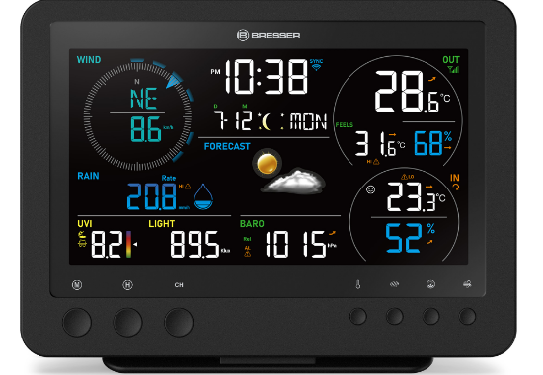
PRIMARY DATA SOURCE: JENA CLIMATE
DATASET PROFILE
Temporal Scope: 2009 — 2016 (8 Full Years)
Granularity: Original 10-minute intervals
Core Metrics: Temperature (°C), Humidity (%), Pressure (mbar)
The dataset includes full summer cycles, providing critical data for tracking extreme heat events and prolonged dry spells necessary for fire weather modeling.
Notes:
[Sources]
- Weather Archive Jena dataset and research sources listed on slide 26.
- Fire_Weather_Monitoring_Deep_Dive.docx.

Slide 4






THE ENGINEERING PIPELINE
Temporal Resampling
Statistical Cleaning
Reproducible Python
Resampled 10-minute sensor bursts into hourly medians to smooth signal noise while preserving long-term seasonal macro-trends.
Applied 1.5 x IQR filtering after hourly resampling: keep temperature and pressure values within Q1 - 1.5*IQR and Q3 + 1.5*IQR. RH stays bounded at 0-100%.
Converted notebook experiments into repeatable Python training, saved model bundles, and a standalone Flask inference service.
Notes:
[Sources]
- Weather Archive Jena dataset and research sources listed on slide 26.
- Fire_Weather_Monitoring_Deep_Dive.docx.

Slide 5
DATA QUALITY & VOLUME
420k+
ADVANCED FILTERING LOGIC
By leveraging the entire 2009-2016 timeline rather than small slices, the project achieves a comprehensive understanding of standard baselines versus outlier danger events.
Raw Observations Analyzed
70k+
•
IQR-filtered temperature and pressure anomalies
•
Verified full seasonal coverage (Summer/Winter)
•
Standardized measurement units for accuracy
Cleaned Hourly Data Points
Notes:
[Sources]
- Weather Archive Jena dataset and research sources listed on slide 26.
- Fire_Weather_Monitoring_Deep_Dive.docx.

Slide 6

REFINED RESEARCH QUESTIONS
1. The Tinderbox Correlation
2. Barometric Warning Signals
How many hourly periods meet the 30 C / 30% project screen?
Do rapid three-hour pressure drops appear before the driest hourly windows?
3. Diurnal Danger Cycles
4. Sustained Risk Windows
Which hours show the strongest overlap of heat and low humidity?
After the screen is crossed, how long do elevated conditions continue?
5. Seasonal trends: How do heat, humidity, and pressure shift by season and year?
Notes:
[Sources]
- Weather Archive Jena dataset and research sources listed on slide 26.
- Fire_Weather_Monitoring_Deep_Dive.docx.

Slide 7


Q1: The Tinderbox Correlation
Finding: Extreme Overlap
Simultaneous high heat (30 C or above) and low humidity (30% or below) are rare but important screening cases.
Meteorological Reasoning
Hot, dry air can reduce fine-fuel moisture and make ignition conditions more favorable.
Only 26 of 68,666 hourly events meet this criterion.
Acts as a precise filter for fine-fuel drying.
Used as the project’s main heat-and-dryness screen.
Notes:
[Sources]
- Weather Archive Jena dataset and research sources listed on slide 26.
- Fire_Weather_Monitoring_Deep_Dive.docx.

Slide 8
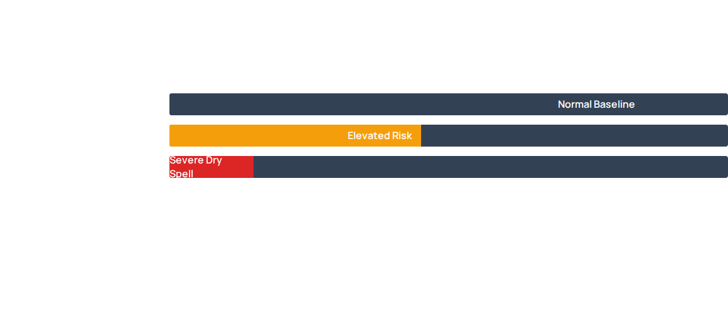
Q2: PRESSURE WARNING SIGNALS
Claim: Pressure is a weak standalone warning signal in this dataset.
Evidence: Only 5% of the most severe dry spells were preceded by a rapid 3-hour pressure drop.
Reasoning: Keep pressure as a supporting feature; temperature and humidity carry the clearer fire-weather signal.
Notes:
[Sources]
- Weather Archive Jena dataset and research sources listed on slide 26.
- Fire_Weather_Monitoring_Deep_Dive.docx.

Slide 9
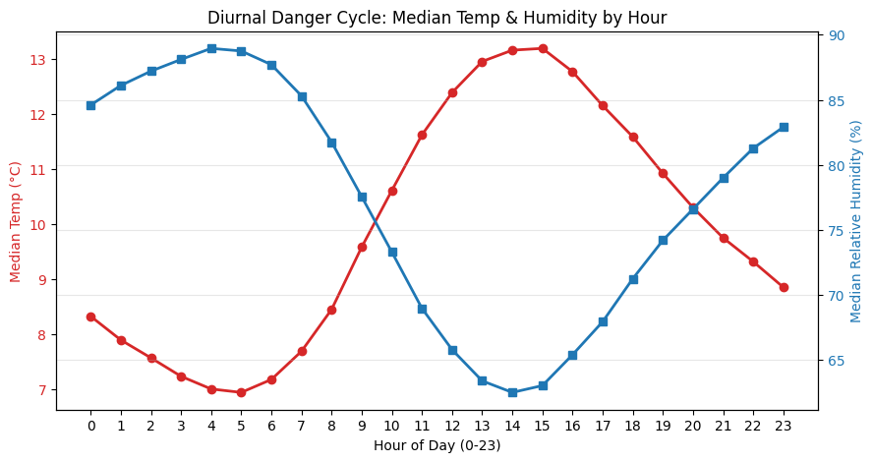
Q3: DIURNAL DANGER CYCLES
Claim: The strongest daily heat-and-dryness overlap appears around 13:00-16:00.
Evidence: Median temperature peaks while humidity reaches its daily low.
Reasoning: This is the clearest afternoon screening window in the Jena dataset.
Notes:
[Sources]
- Weather Archive Jena dataset and research sources listed on slide 26.
- Fire_Weather_Monitoring_Deep_Dive.docx.

Slide 10


Q4: Sustained Risk Windows
Duration vs. Spikes
Operation Impact
Prediction Goal
Isolated spikes in temperature are less dangerous than sustained exposure to hot, dry air.
Risk persists across consecutive hours, requiring long-term alert monitoring.
Models must predict not just the threshold, but the *length* of the danger window.
Notes:
[Sources]
- Weather Archive Jena dataset and research sources listed on slide 26.
- Fire_Weather_Monitoring_Deep_Dive.docx.

Slide 11


Q5: SEASONAL MACRO-TRENDS
SPRING (MAR-MAY)
SUMMER (JUN-AUG)
AUTUMN (SEP-NOV)
WINTER (DEC-FEB)
Rising temps, high variability.
Peak Fire Season. Max risk overlap.
Decreasing vulnerability.
Stable moisture, low risk.
Claim: Summer has the clearest elevated-risk baseline.
Evidence: Median temperatures rise about 12°C while humidity drops about 15% versus winter.
Reasoning: Seasonal aggregation over 8 summers reduces dependence on any single extreme year.
Notes:
[Sources]
- Weather Archive Jena dataset and research sources listed on slide 26.
- Fire_Weather_Monitoring_Deep_Dive.docx.

Slide 12
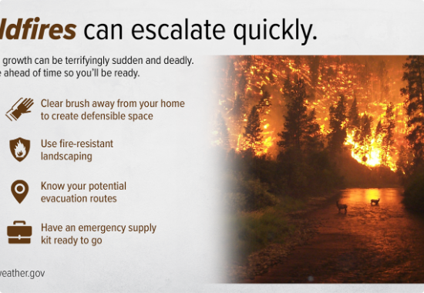
KEY FINDINGS & IMPLICATIONS
MODEL FOUNDATION
Data: strong for sensor EDA; limited for fire outcomes.
Cleaning: 1,463 anomalies removed; 68,666 rows retained.
CER: each question now links claim, evidence, reasoning.
Final Build: EDA findings now support a complete MQTT, PostgreSQL, read-only dashboard, live-stream, and ML-service demonstration.
Notes:
[Sources]
- Weather Archive Jena dataset and research sources listed on slide 26.
- Fire_Weather_Monitoring_Deep_Dive.docx.

Slide 13
MACHINE LEARNING
Final service: one linear task and two logistic tasks; K-Means remains an early experiment.
Notes:
[Sources]
- ai_worker/models/manifest.json
- ai_worker/train_models.py
- ai_worker/ml_service.py

Slide 14
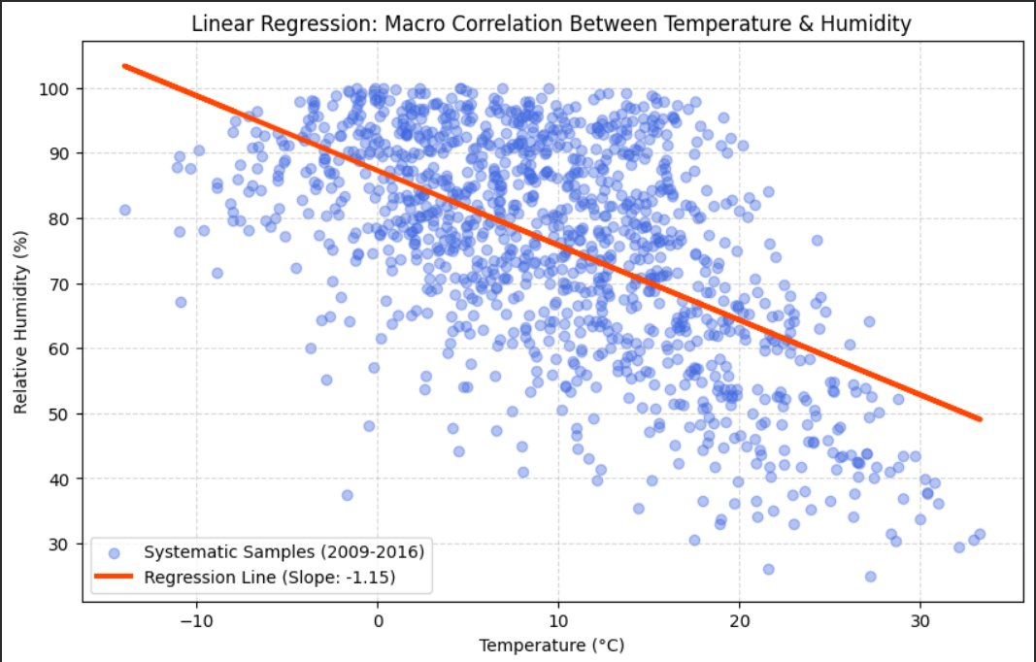
Linear Regression
Task: Estimate relative humidity from temperature and pressure.
Held-out result: R² 0.3189 and MAE 11.05 percentage points.
Use: A baseline weather estimate—not a wildfire forecast.
Notes:
[Sources]
- ai_worker/models/manifest.json
- ai_worker/train_models.py
- ai_worker/ml_service.py

Slide 15
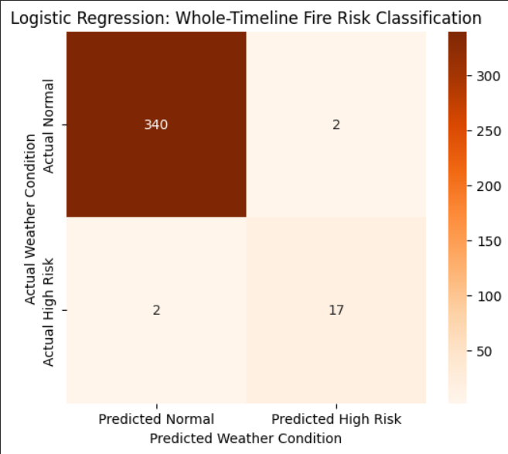
Logistic Regression
Task: Estimate whether relative humidity is below the 30% project screen.
Rare class: Only 0.22% positives in the Jena evaluation.
Evaluation: Report precision, recall, F1, and ROC-AUC—not accuracy alone.
Notes:
[Sources]
- ai_worker/models/manifest.json
- ai_worker/train_models.py
- ai_worker/ml_service.py

Slide 16
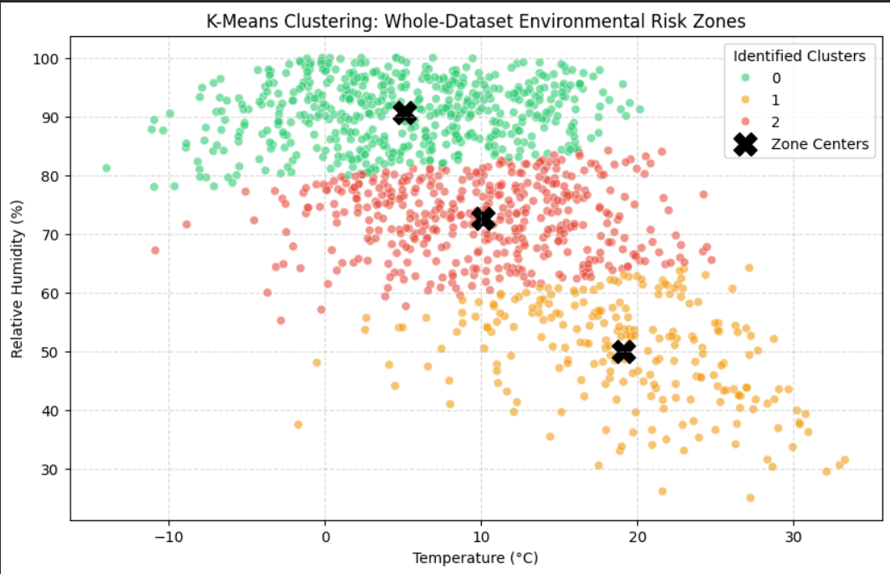
K-Means (Early Experiment)
Exploration: Grouped weather observations into three environmental regimes.
Final decision: - Preserve the experiment - Exclude it from the final service - Ship only tasks tied to clear user questions
Lesson: An interesting algorithm is not automatically the right production feature.
Notes:
[Sources]
- ai_worker/models/manifest.json
- ai_worker/train_models.py
- ai_worker/ml_service.py

Slide 17
FINAL ML SERVICE
Saved models load once; the dashboard submits one event and displays one prediction.
Notes:
[Sources]
- ai_worker/models/manifest.json
- ai_worker/train_models.py
- ai_worker/ml_service.py

Slide 18
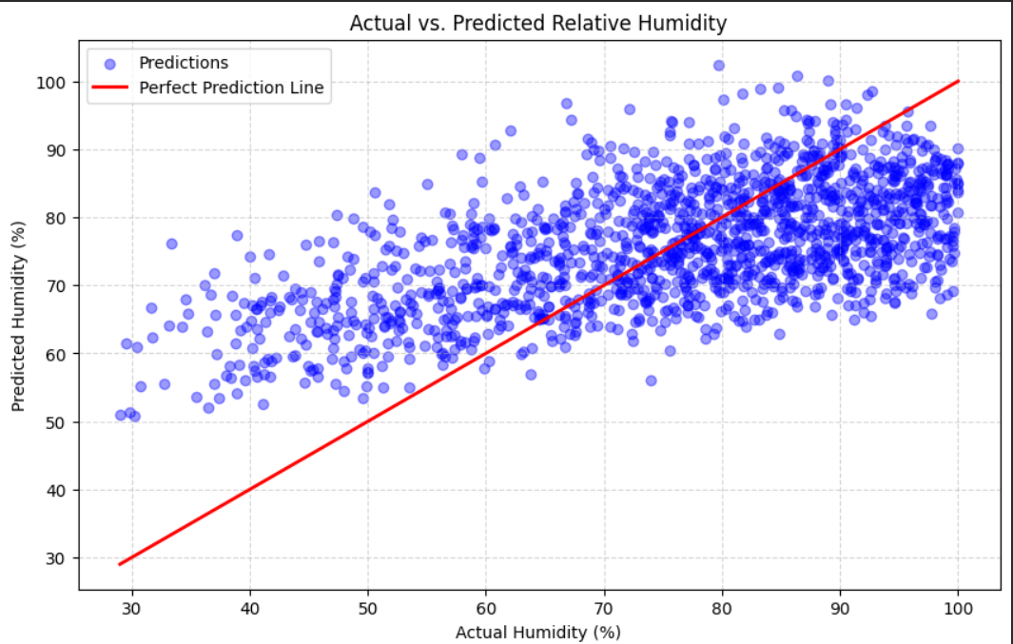
How accurately can temperature and pressure estimate relative humidity?
Inputs: One event's temperature and pressure.
Output: Predicted relative humidity percentage.
Held-out metrics: R² 0.3189; MAE 11.05 percentage points.
Meaning: Useful as a baseline relationship, not an ignition forecast.
Notes:
[Sources]
- ai_worker/models/manifest.json
- ai_worker/train_models.py
- ai_worker/ml_service.py

Slide 19
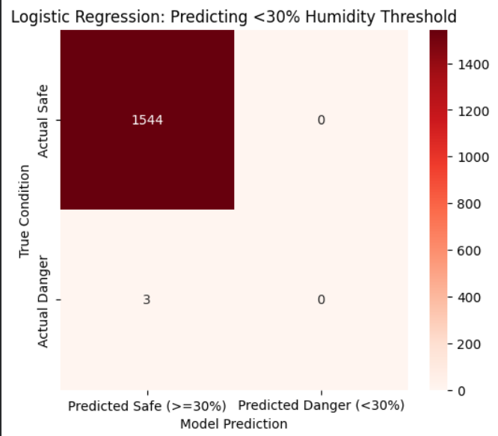
Will relative humidity fall below the project's 30% screening threshold?
Model: Logistic regression with a validation-selected threshold.
Output: Probability plus a low-humidity classification.
Rare event: 0.22% positive rate in the Jena evaluation.
Meaning: Review precision and recall before trusting the label.
Notes:
[Sources]
- ai_worker/models/manifest.json
- ai_worker/train_models.py
- ai_worker/ml_service.py

Slide 20
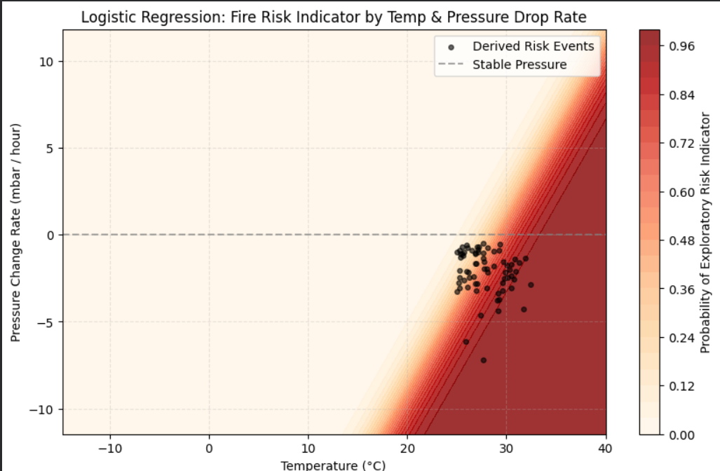
Can temperature plus pressure change flag an exploratory pressure-risk event?
Input: One current event; prior pressure comes from PostgreSQL.
Feature: Pressure change per hour over elapsed time.
Output: Probability from the saved logistic model.
Meaning: A supporting signal—not proof of wind or wildfire.
Notes:
[Sources]
- ai_worker/models/manifest.json
- ai_worker/train_models.py
- ai_worker/ml_service.py

Slide 21
END-TO-END SYSTEM ARCHITECTURE
1. Event generator shapes repeatable measurement scenarios.
2. Mosquitto carries raw telemetry through MQTT.
3. Subscriber validates each event and writes raw + flattened PostgreSQL rows atomically.
4. Read-only API serves analytics and a persistent Server-Sent Events stream.
5. Dashboard shows Analytics, Live Event Stream, and Machine Learning tabs.
6. Separate Flask service loads saved models and predicts one event at a time.
Notes:
[Sources]
- docs/FIRE_DATA_CONTRACT.md
- backend source files
- Local integration validation completed August 3, 2026.

Slide 22
RAW EVENT & DATABASE CONTRACT
Raw MQTT message
Identifiers, timestamp, and sensor measurements only. No scenario, severity, outlier, quality, status, or risk labels.
Subscriber enrichment
Validates measurements; derives quality, scenario classification, severity, outlier state, and a transparent screening score.
Atomic storage
jena_telemetry preserves original JSON for audit. fire_weather_events stores flattened fields for queries, exports, and the dashboard.
Notes:
[Sources]
- docs/FIRE_DATA_CONTRACT.md
- backend source files
- Local integration validation completed August 3, 2026.

Slide 23
DASHBOARD & LIVE STREAM
Analytics
Database filters, KPIs, trends, scenario coverage, and attention items.
Live Event Stream
A persistent Server-Sent Events connection pushes newly committed rows immediately as readable event cards.
Machine Learning
A form sends one event through the dashboard API to the standalone service on port 5001.
Boundary
The browser is read-only: it never publishes MQTT events or writes to PostgreSQL.
Notes:
[Sources]
- docs/FIRE_DATA_CONTRACT.md
- backend source files
- Local integration validation completed August 3, 2026.

Slide 24
VALIDATION, LIMITATIONS & NEXT STEP
Validated locally
PostgreSQL and Mosquitto ran successfully; 1,150 persisted events were reported; API health, all three tabs, live updates, and ML predictions worked.
Important limitation
Jena contains weather measurements, not ignition or burned-area outcomes. The score and models are educational screening signals.
Next edge step
Add real Arduino sketches, documented sensors, and hardware photos after physical testing.
Notes:
[Sources]
- docs/FIRE_DATA_CONTRACT.md
- backend source files
- Local integration validation completed August 3, 2026.

Slide 25
FINAL SYSTEM
Conference-ready and reproducible.
Research → MQTT → PostgreSQL → Read-only Dashboard → ML Service ByteSmart Internship Portfolio
Notes:
[Sources]
- docs/FIRE_DATA_CONTRACT.md
- backend source files
- Local integration validation completed August 3, 2026.

Slide 26
SOURCES & DATA REFERENCES
https://www.theweathernetwork.com/en/news/weather/severe/how-the-30-30-30-rule-is-essential-for-wildfire-safety
https://www.weather.gov/safety/wildfire-ww
https://www.weather.gov/fire/
https://firms.modaps.eosdis.nasa.gov/
https://archive.ics.uci.edu/dataset/162/forest+fires
https://www.kaggle.com/datasets/pankrzysiu/weather-archive-jena
https://www.w3schools.com/python/
Notes:
[Sources]
- Sources and project files listed in the presentation and final package.

Slide 27



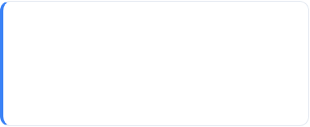
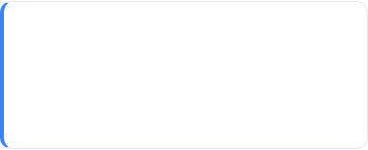




Glossary: Project Terms
EDA
Jena Dataset
Resampling
The "detective work" phase—looking for patterns and clues in the data before making big decisions.
A massive library of 7 years of weather records (temperature, humidity, pressure) used for practice.
Cleaning up "jittery" data by turning messy minute-by-minute notes into smooth hourly averages.
CER Map
IQR Filtering
30/30 Rule
A logic bridge that connects a Claim to hard Evidence and logical Reasoning.
Using math to spot and delete "glitchy" sensor numbers that are way too high or low to be real.
The fire danger zone: When it is hotter than 30°C and drier than 30% humidity at the same time.
MQTT
PostgreSQL
SSE
A lightweight publish/subscribe protocol used to carry raw weather events through Mosquitto.
The database that preserves raw payloads and flattened dashboard records before display.
Server-Sent Events keep one connection open so newly committed rows appear immediately.
ByteSmart Internship | Fire Weather Monitoring Project
Notes:
[Sources]
- Sources and project files listed in the presentation and final package.

